Slide 1
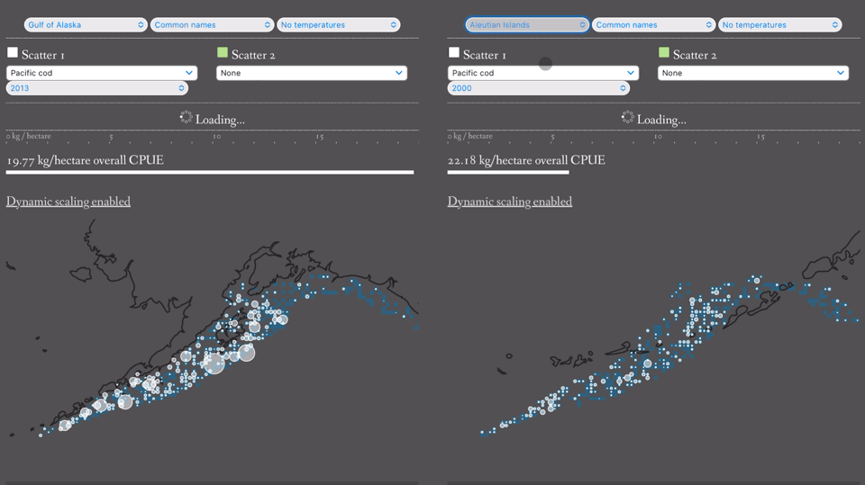
A Samuel Pottinger
Jan 25, 2025
Stat 198: Interactive Data
Science and Visualization
Lecture 2

Slide 2
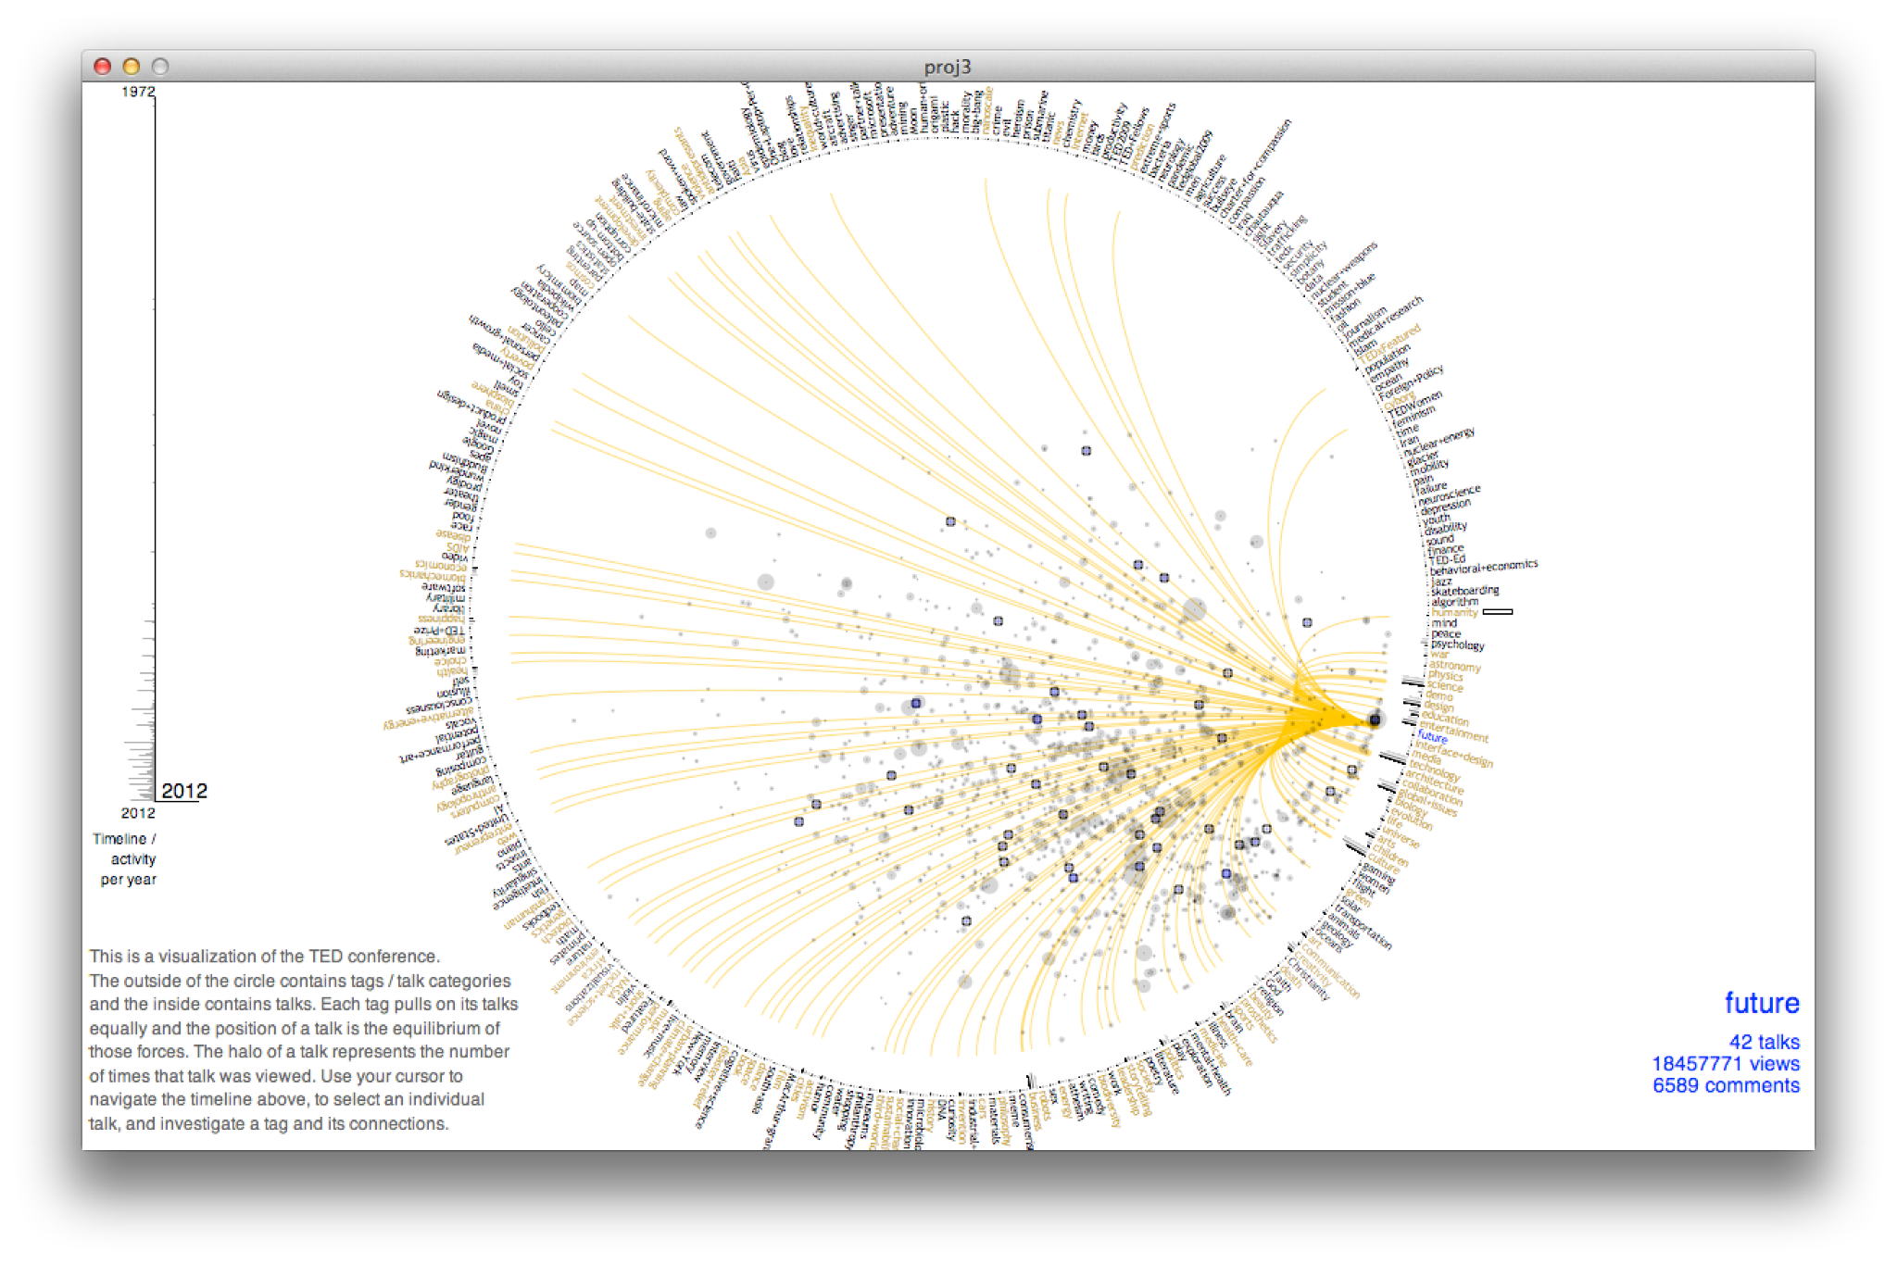
Today
Reminder of the 4 perspectives
Group activity

Slide 3
Data Visualization in 4 Acts
As representation
As task
As message
As dialogue

Slide 4
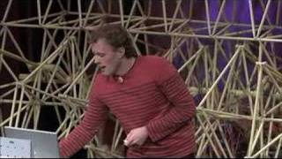
Warm Up

Slide 5
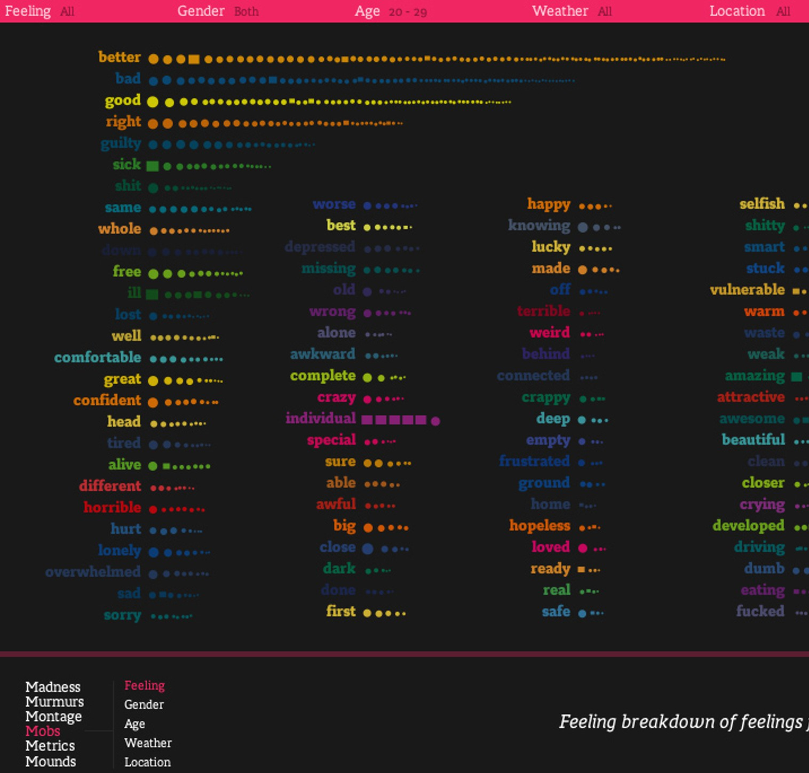
Warm Up
Perspective 1: What are the data attribute and their encodings?
Perspective 2: What task or user journey is being accomplished through the piece?
Perspective 3: Does the piece try to also convey an emotion and, if so, how?
Perspective 4: Does the piece invite the reader to reach new their own conclusions about the data and, if so, how?

Slide 6
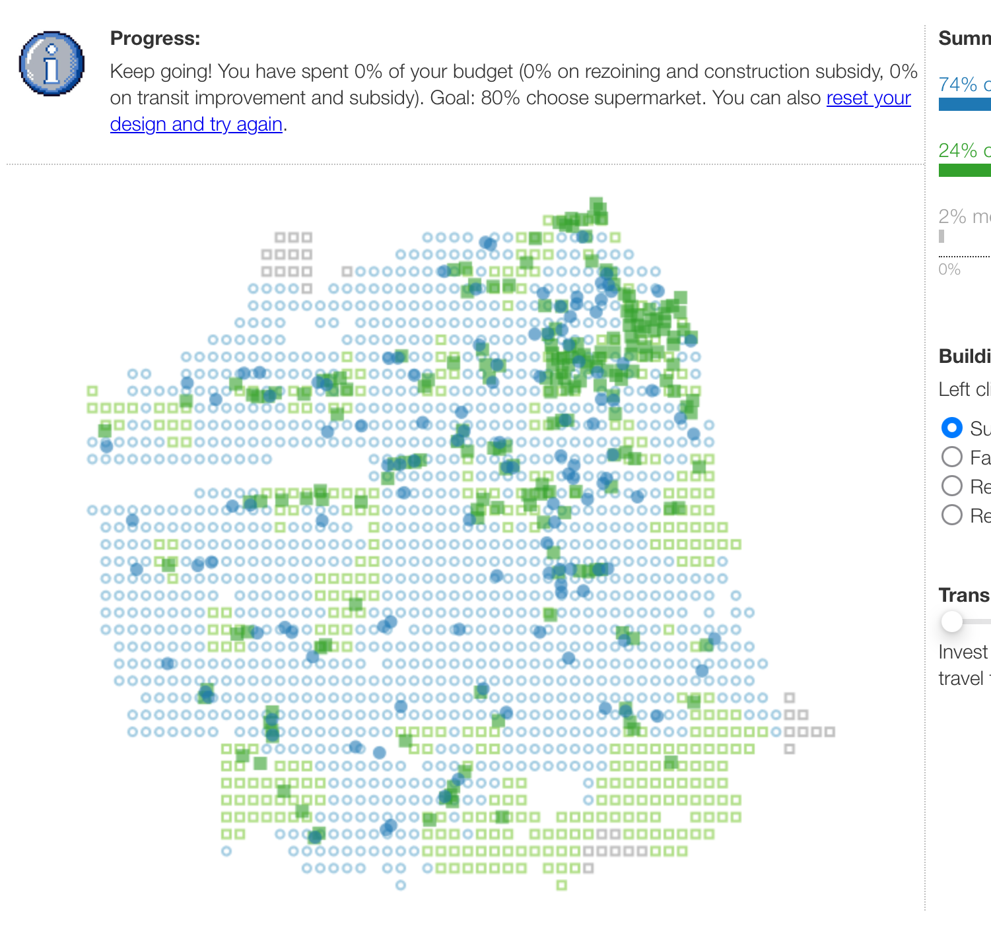
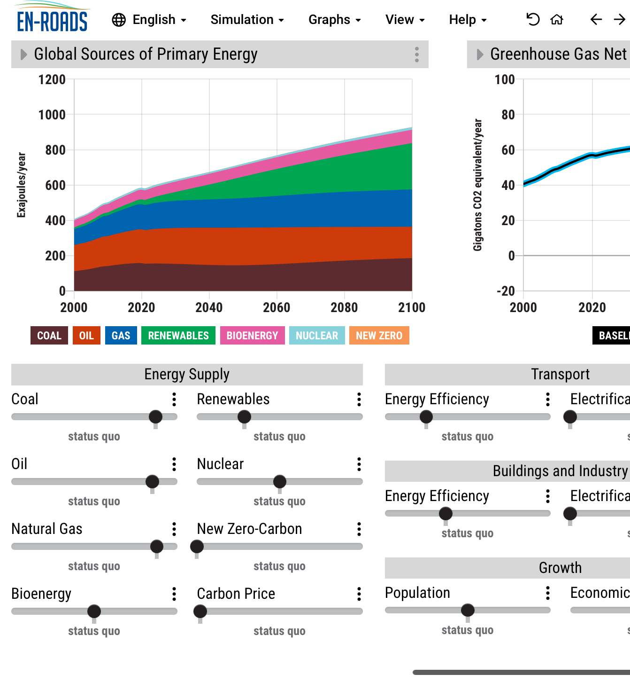
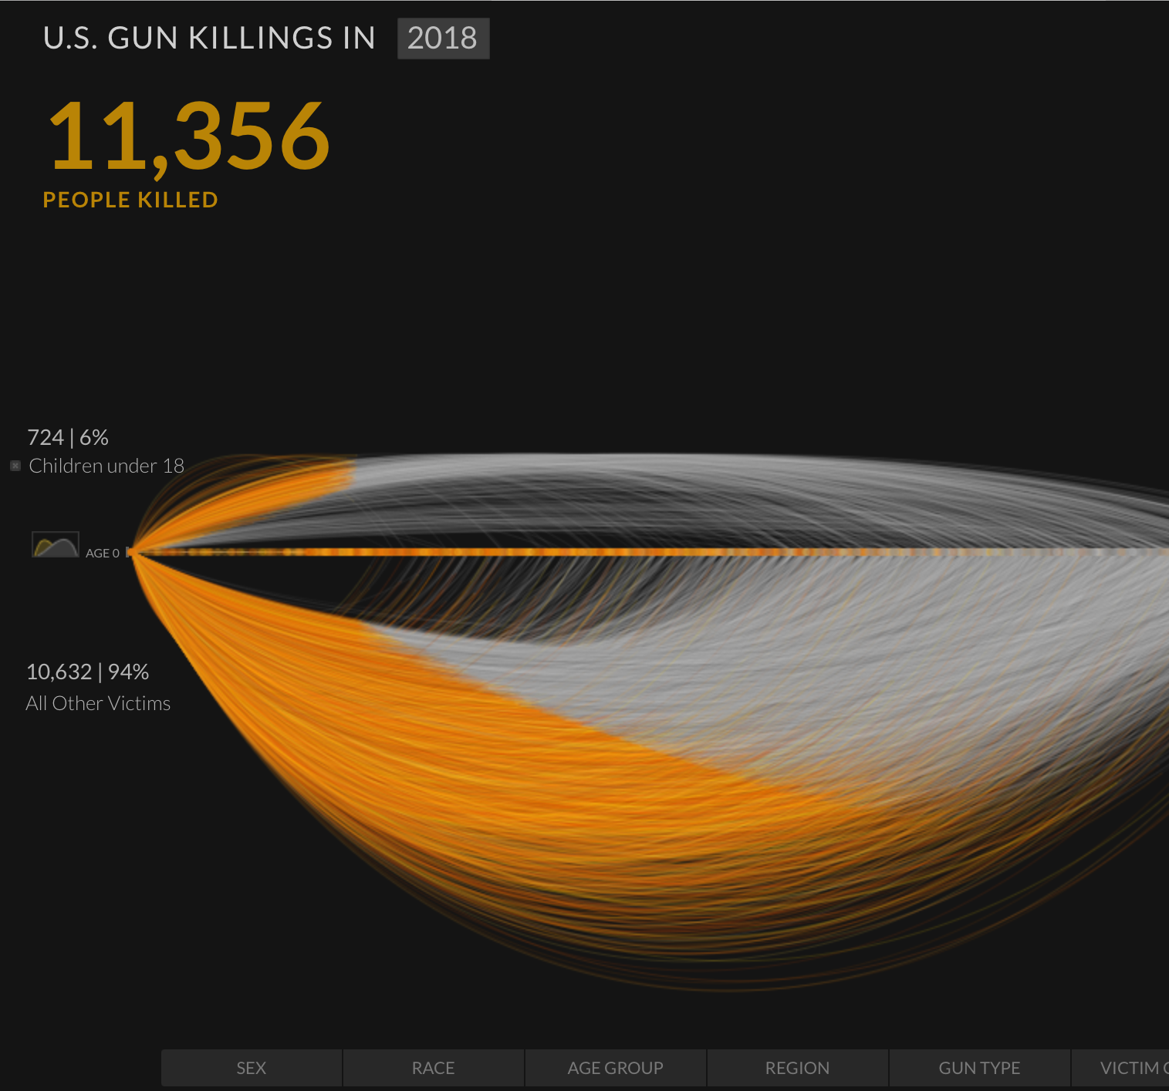
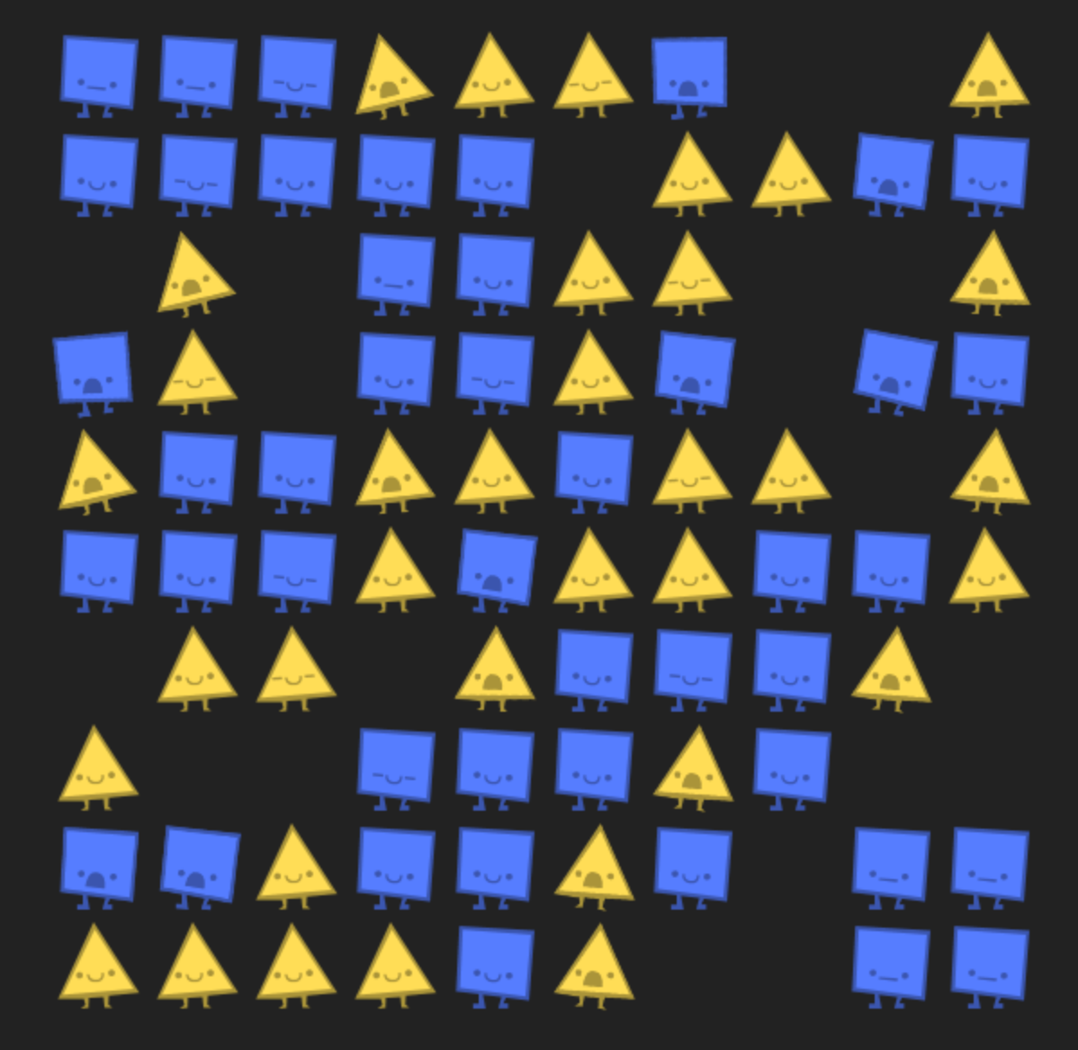
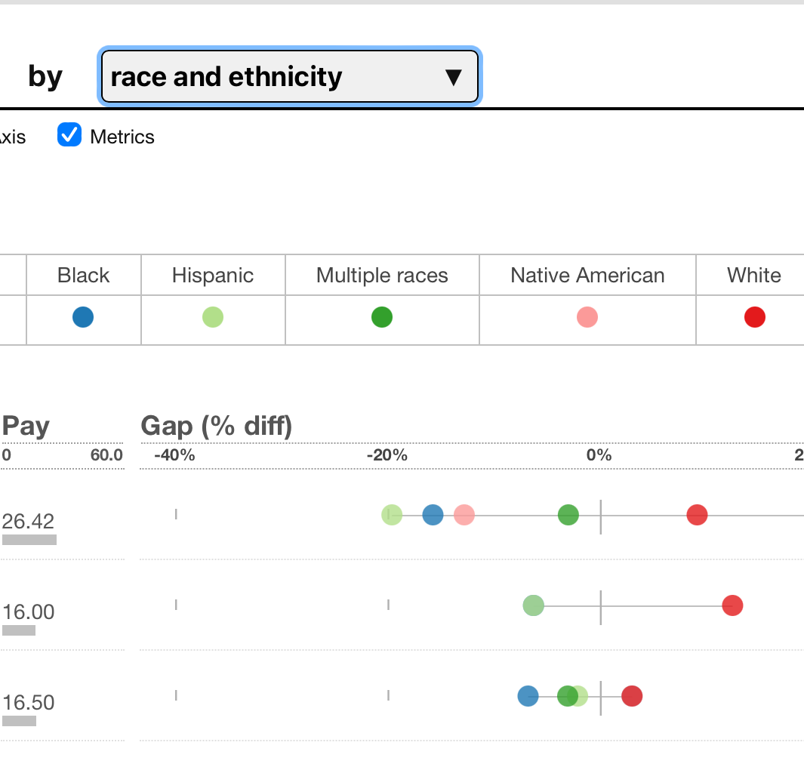
Break into groups of 3-4: try out a visualization and report back.
en-roads.climate
interactive.org
foodsimsf.com
Perspective 1: What are the data attribute and their encodings?
Perspective 2: What task or user journey is being accomplished through the piece?
Perspective 3: Does the piece try to also convey an emotion and, if so, how?
Perspective 4: Does the piece invite the reader to reach new their own conclusions about the data and, if so, how?
guns.
periscopic.org
ncase.me/polygons
incomegaps.com

Slide 7
Skills Labs!

Slide 8
Works Cited

Slide 9
[1]
G. Aisch, A. Cox, and K. Quealy, “You Draw It: How Family Income Predicts Children’s College Chances.” The New York Times Company, May 28, 2015. [Online]. Available: https://www.nytimes.com/interactive/2015/05/28/upshot/you-draw-it-how-family-income-affects-childrens-college-chances.html
[2]
R. Binx, “Vortex.” 2015. [Online]. Available: https://rachelbinx.com/data-visualization/vortex
[3]
R. Binx, “Designing for Realtime Spacecraft Operations.” BocoupLLC, Apr. 2016. [Online]. Available: https://www.youtube.com/watch?v=HuYKhSHcRSQ
[4]
Book Books Book, “We Feel Fine.” YouTube, Dec. 2009. [Online]. Available: https://www.youtube.com/watch?v=vi8WrnWNSzU
[5]
W. S. Cleveland and R. McGill, “Graphical Perception: Theory, Experimentation, and Application to the Development of Graphical Methods,” Journal of the American Statistical Association, vol. 79, no. 387, pp. 531–554, Sep. 1984, doi: 10.1080/01621459.1984.10478080.
[6]
Flipflops, “I feel… everything.” Flipflops.org, Oct. 2007. [Online]. Available: https://www.flipflops.org/category/thoughtful/page/2/
[7]
V. Hart and N. Case, “Parable of the Polygons.” Nicky Case, 2022. [Online]. Available: https://ncase.me/polygons/
[8]
Isle Royale National Park MIchigan, “Wolf & Moose Populations.” National Parks Service, Mar. 29, 2024. [Online]. Available: https://www.nps.gov/isro/learn/nature/wolf-moose-populations.htm
[9]
S. D. Kamvar and J. Harris, “We feel fine and searching the emotional web,” in Proceedings of the fourth ACM international conference on Web search and data mining, Hong Kong China: ACM, Feb. 2011, pp. 117–126. doi: 10.1145/1935826.1935854.
[10]
A. KIRK, DATA VISUALISATION: a handbook for data driven design. S.l.: SAGE PUBLICATIONS, 2024.
[11]
A. Kirk, “Visualizing Data.” Visualising Data Ltd, 2024. [Online]. Available: https://visualisingdata.com/
[12]
T. Munzner, “A Nested Model for Visualization Design and Validation,” IEEE Trans. Visual. Comput. Graphics, vol. 15, no. 6, pp. 921–928, Nov. 2009, doi: 10.1109/TVCG.2009.111.
[13]
T. Munzner, “Visualization Analysis and Design.” AK Peters Visualization Series, 2014. [Online]. Available: https://books.apple.com/us/book/visualization-analysis-and-design/id1567434451
[14]
T. Munzner, Visualization analysis and design. in A.K. Peters visualization series. Boca Raton: CRC Press, Taylor & Francis Group, CRC Press is an imprint of the Taylor & Francis Group, an informa business, 2015.
[15]
T. Munzner, “Task Abstraction (Ch 3), Visualization Analysis & Design, 2021.” YouTube, 2021. [Online]. Available: https://www.youtube.com/watch?v=pHljd-cgICY
[16]
M. Nix, Visual simplexity: die Darstellung großer Datenmengen. Frankfurt am Main: entwickler.press, 2013.
[17]
Periscopic, “U.S. Gun Deaths.” Periscopic, 2018. [Online]. Available: https://guns.periscopic.com/
[18]
A. Pottinger, “FoodSim: San Francisco.” 2023. [Online]. Available: https://foodsimsf.com/
[19]

Slide 10
[19]
A. Pottinger, “Income Gaps.” 2023. [Online]. Available: https://incomegaps.com/
[20]
A. Pottinger, “Interactive Data Science.” 2024. [Online]. Available: https://interactivedatascience.courses/
[21]
A. S. Pottinger et al., “Combining Game Design and Data Visualization to Inform Plastics Policy: Fostering Collaboration between Science, Decision-Makers, and Artificial Intelligence,” 2023, arXiv. doi: 10.48550/ARXIV.2312.11359.
[22]
A. S. Pottinger, L. Connor, B. Guzder-Williams, M. Weltman-Fahs, and T. Bowles, “Climate-Driven Doubling of Maize Loss Probability in U.S. Crop Insurance: Spatiotemporal Prediction and Possible Policy Responses,” 2024, arXiv. doi: 10.48550/ARXIV.2408.02217.
[23]
A. S. Pottinger and G. Zarpellon, “Pyafscgap.org: Open source multi-modal Python-basedtools for NOAA AFSC RACE GAP,” JOSS, vol. 8, no. 86, p. 5593, Jun. 2023, doi: 10.21105/joss.05593.
[24]
J. N. Rooney-Varga, F. Kapmeier, J. D. Sterman, A. P. Jones, M. Putko, and K. Rath, “The Climate Action Simulation,” Simulation & Gaming, vol. 51, no. 2, pp. 114–140, Apr. 2020, doi: 10.1177/1046878119890643.
[25]
J. Schell, The art of game design: a book of lenses, Third edition. Boca Raton: CRC Press/Taylor & Francis Group, 2020.
[26]
J. Snow, On the mode of communication of cholera. London: John Churchill, 1855. [Online]. Available: https://archive.org/details/b28985266/page/n57/mode/2up
[27]
J. Stasko, C. Gorg, Z. Liu, and K. Singhal, “Jigsaw: Supporting Investigative Analysis through Interactive Visualization,” in 2007 IEEE Symposium on Visual Analytics Science and Technology, Sacramento, CA, USA: IEEE, Oct. 2007, pp. 131–138. doi: 10.1109/VAST.2007.4389006.
[28]
The Document Foundation, LibreOffice. (2024). The Document Foundation.
[29]
ThoughtLab, The Wendy and Eric Schmidt Center for Data Science and Environment, and Benioff Ocean Science Laboratory, “A Treaty to End Plastic Pollution. Forever.” University of California, 2023. [Online]. Available: https://plasticstreaty.berkeley.edu/
[30]
B. Victor, “Inventing on Principle.” CUSEC, 2012. [Online]. Available: https://www.youtube.com/watch?v=PUv66718DII
[31]
B. Victor, “Media for Thinking the Unthinkable.” MIT Media Lab, Apr. 04, 2013. [Online]. Available: https://vimeo.com/67076984
[32]
Visual Computing BLOG, “Tamara Munzner discussed quantification in terms of a nested model of visualization design and evaluation.” Transregional Collaborative Research Center. [Online]. Available: https://www.visual-computing.org/2018/10/17/computerscienceconferenceweek/201810_conferenceweek_munzner-2/
[33]
C. Ware, “Colin Ware | The Data Visualzation Research Lab.” University of New Hampshire. [Online]. Available: https://ccom.unh.edu/vislab/people/colin_ware/
[34]
C. Ware, Information visualization: perception for design, Fourth edition. Cambridge, MA: Morgan Kaufmann, 2021.
[35]
Wikipedia Contributors, “Snow-cholera-map-1.jpg.” Wikimedia Foundation, Inc., 2020. [Online]. Available: https://en.wikipedia.org/wiki/File:Snow-cholera-map-1.jpg
[36]

Slide 11
[36]
Wikipedia Contributors, “Bret Victor.” Wikimedia Foundation, Inc., Jun. 22, 2023. [Online]. Available: https://en.wikipedia.org/wiki/Bret_Victor
[37]
Wikipedia Contributors, “Star Wars: Galaxy’s Edge.” Wikimedia Foundation, Inc., Sep. 21, 2024. [Online]. Available: https://en.wikipedia.org/wiki/Star_Wars:_Galaxy%27s_Edge
[38]
Wikipedia Contributors, “It’s a Small World.” Wikimedia Foundation, Inc., Sep. 24, 2024. [Online]. Available: https://en.wikipedia.org/wiki/It%27s_a_Small_World
[39]
N. Yee, “Motivations for Play in Online Games,” CyberPsychology & Behavior, vol. 9, no. 6, pp. 772–775, Dec. 2006, doi: 10.1089/cpb.2006.9.772.
J. Harris and S. Kavar, “We Feel Fine.” We Feel Fine., 2006. [Online]. Available: http://www.wefeelfine.org and https://jjh.org/we-feel-fine.
J. Harris, “The Web’s Secret Stories.” TED Conference., 2007. [Online]. Available: https://youtu.be/zAvNlh2Z0GI?feature=shared.
Thanks to https://unsplash.com/photos/DHl49oyrn7Y

Slide 12


